Slide 1
FUNCTIONS OF SOCIAL WORK

Slide 2
Curative Function
The services provided under curative functions are–medical and health services, services relating to psychiatry, child guidance, child welfare services, and services for the handicapped or disabled in the form of protection and rehabilitation. These kinds of services aim to cure the physical, social, material, and psychological sickness of individuals in society.

Slide 3
CORRECTIONAL FUNCTION
The correctional function of social work has three broad areas, such as:
a) Individual reform service which includes prison reform, probation, parole and other related services.
b) Services for improving social relationship which includes family welfare services, school social work, industrial social work etc.
c) Services for social reform that includes employment services, beggary prohibition services

Slide 4
PREVENTIVE FUNCTION
It includes life insurance services, public assistance, social legislation, adult education and prevention of diseases etc.
This type of function basically deals with the services relating to the prevention of problems like insecurity, unlawfulness, ignorance, sickness etc.
It is directed towards the elimination of those factors in the social environment or those deficiencies in the development of personality that prevents the individual from achieving a minimum desirable standard of socio-economic life.

Slide 5
DEVELOPMENTAL FUNCTION
The developmental function includes the tasks of socio-economic development activities such as education, recreational services, urban and rural development programs and programs of integration etc which are primarily concerned with the development of individuals, families, groups and communities.

Slide 6
THE 12 GRAND CHALLENGES IN SOCIAL WORK
NOTES GIVEN.
PLEASE READ AND SUMMARIZE THE INFORMATION ON YOUR REGISTERS.
IT WILL BE CHECKED.
CLASS DISCUSSION

Slide 7
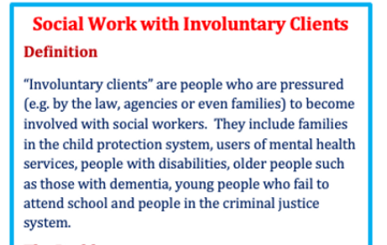
Voluntary social work is one of the characteristics of social work that is based on the cooperation of individuals with each other in order to meet the needs of their community.
Voluntary social work can be defined as the contribution of individuals to care and social development, whether through work, funding, or other forms. Social work within the voluntary sector can involve supporting older people, adults with mental health or physical disabilities, or young people who might be unemployed or homeless. Volunteering does not require formal qualifications and volunteers are usually involved in short-term projects that do not require professional

Slide 8
Professional social work
Professional social work is a practice-based profession and an academic discipline that aims to promote social change and development, social cohesion, and the empowerment and liberation of people.
It is guided by principles of social justice, human rights, collective responsibility, and respect for diversities

